Slide 1


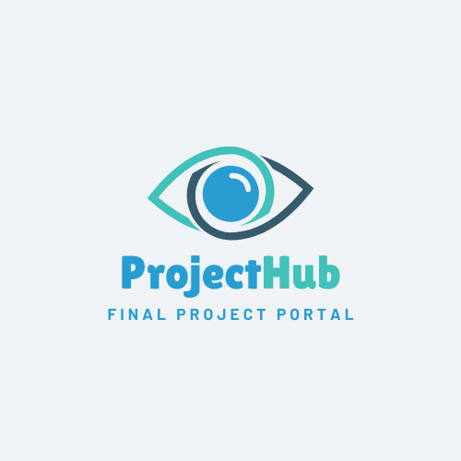




ProjectHub
www.ProjectHub.co.il
Final Projects Portal: Streamlining Academic Management
24-2-D-10
Noy Malka & Noa Krispin Suprevised By Dr. Julia Sheidin

Slide 2

ProjectHub
Background
www.ProjectHub.co.il
Background
Final projects are a key part of the undergraduate Bachelor's degree, allowing students to apply their theoretical knowledge to real-world challenges.
The project is divided into two phases:
Phase A: Research and project proposal.
Phase B: Implementation and testing.
Students gain hands-on experience, teamwork skills and create practical solutions.
The process enhances communication skills and prepares students for professional careers.

Slide 3




ProjectHub
Background
www.ProjectHub.co.il
Key Stakeholders
Students
Supervisors
Final Project Coordinators & Admin Staff
Panel Members

Slide 4

Development Process
ProjectHub
Background
www.ProjectHub.co.il
Development Process
Interviews
We began the development process by conducting interviews with key individuals.
This led us to interview the project coordinators, Julia and Naomi, and our department secretary, Ora, who are the main figures responsible for the final project process.
Current Process
Identifying Key Challenges
WBS

Slide 5
Development Process
ProjectHub
Background
www.ProjectHub.co.il
Current Process
Interviews
Students Search for Supervisors.
Students Register the Project.
Cross-Check Data by Admin Staff.
Coordination for Presentations.
Grade Collection, Track Grades, and Send Reminders.
Current Process
GoogleSheet
Identifying Key Challenges
WBS

Slide 6
Development Process
ProjectHub
Background
www.ProjectHub.co.il
Identifying Key Challenges
Interviews
Lack of Centralized Communication
Disconnected channels make it difficult to streamline project coordination.
Manual Tracking and Data Entry
Data is tracked manually using Google Sheets and Excel.
Delays in Submitting Scores
Manual collection of grades and feedbacks.
Time-Consuming Presentation Scheduling
Scheduling presentations involves multiple email follow-ups.
Current Process
Identifying Key Challenges
WBS

Slide 7
Development Process
ProjectHub
Background
www.ProjectHub.co.il
Final Project
Identify potential supervisors
Submit project proposal
Supervisor review and approval
Forward proposal to coordinators
Coordinator approval
Book Submission, System Testing, and Grading
Submit project presentation form
Record project presentation grade
Provide guest access for viewing
Consolidate project scores
Grade project book
Presentation Scheduling and Coordination
Coordinate panel availability
Conduct final presentation
Schedule presentation dates
Finding a Supervisor and Project Approval
Provide feedback to students
Work Breakdown Structure
Students need a simple way to find topics and track progress.
Lecturers need tools to manage topics and submissions.
Administrative staff need systems for efficient data management and error reduction.

Slide 8

Development Process
Proposed Solution
ProjectHub
Background
www.ProjectHub.co.il
Proposed Solution
Centralized Final Project Management Platform
Centralized platform for efficient management of final projects.
It will focus on the project’s book submission, system testing, and grading, addressing the needs of students, lecturers, and administrative staff.

Slide 9
Development Process
Proposed Solution
ProjectHub
Background
www.ProjectHub.co.il
Proposed Solution
Key Features
Centralized Project Management All stakeholders are brought together on one platform.
Automated System Testing Built-in tools streamline system testing and verification.
Automated Grading Process Supervisors and panel members submit grades and feedbacks directly through the platform.
Centralized Feedback Collection Students access feedback from panel members and supervisors.
Progress Tracking and Notifications Tracks progress and sends reminders for deadlines and grades.

Slide 10


ProjectHub
Background
Development Process
Proposed Solution
Project Plan
www.ProjectHub.co.il
Project Plan
Main Goals - Short term
Enhance Final Project Management Efficiency Streamline book submission feedback, system testing, and grading through automation.
Automate Administrative Tasks Reduce manual workload by automating grade entry, reminders and other key tasks.
Improve Communication Enable clearer, real-time communication between students, supervisors, and administrative staff.

Slide 11
ProjectHub
Background
Development Process
Proposed Solution
Project Plan
www.ProjectHub.co.il
Project Plan
Main Goals – Long term
Ensure Timely Project Completion Use automated progress tracking and reminders to ensure projects stay on schedule.
Set Foundations for Future Expansion Build a flexible system ready for future enhancements in Parts 1 and 3 of the process.

Slide 12


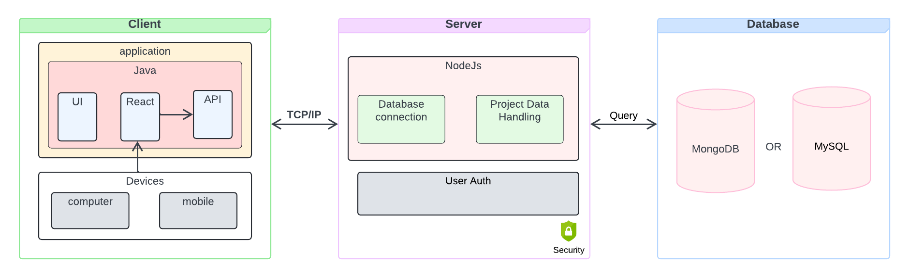
Development Process
Architecture & Key Technologies
ProjectHub
Background
Proposed Solution
Project Plan
www.ProjectHub.co.il
System Architecture

Slide 13




Development Process
Architecture & Key Technologies
ProjectHub
Background
Proposed Solution
Project Plan
www.ProjectHub.co.il
Key Technologies and Algorithms

Slide 14


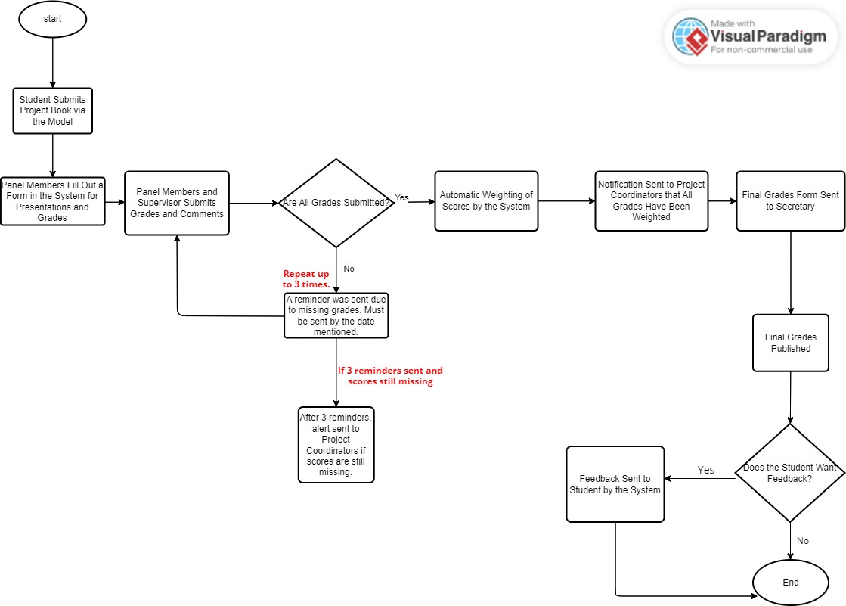
Development Process
Proposed Solution
Key Technologies
ProjectHub
Background
Project Plan
Flowchart
www.ProjectHub.co.il
Flowchart

Slide 15

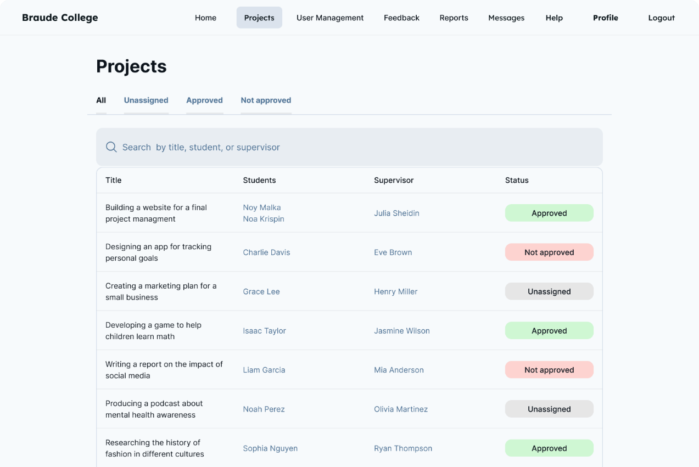
Development Process
Proposed Solution
Key Technologies
ProjectHub
Background
Project Plan
Flowchart
GUI
www.ProjectHub.co.il
GUI Prototype

Slide 16
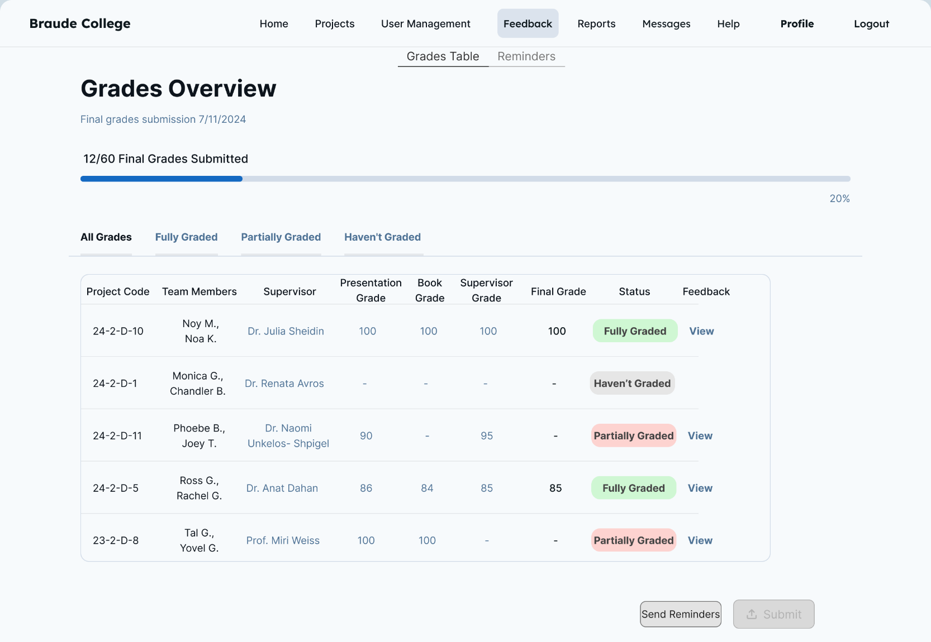
Development Process
Proposed Solution
Key Technologies
ProjectHub
Background
Project Plan
Flowchart
GUI
www.ProjectHub.co.il
GUI Prototype

Slide 17
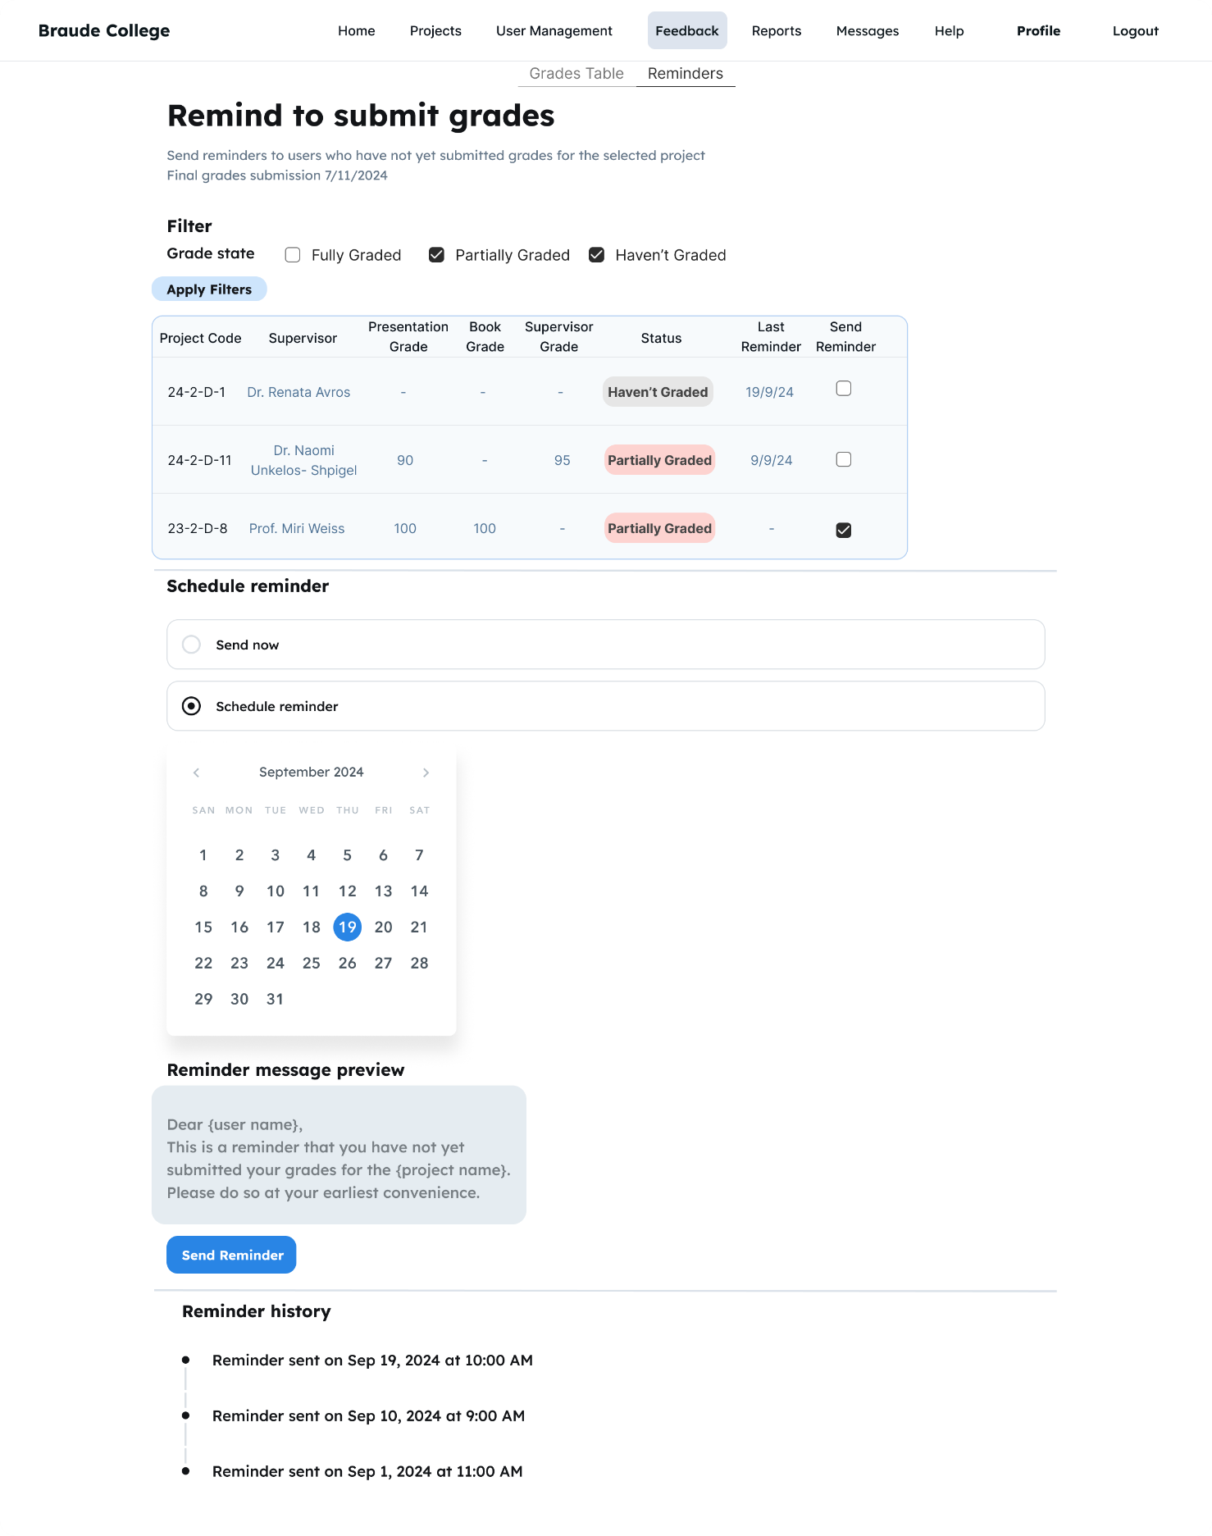
Development Process
Proposed Solution
Key Technologies
ProjectHub
Background
Project Plan
Flowchart
GUI
www.ProjectHub.co.il
GUI Prototype

Slide 18
Development Process
Proposed Solution
Key Technologies
ProjectHub
Background
Project Plan
Flowchart
GUI
www.ProjectHub.co.il
GUI Prototype

Slide 19

Development Process
Proposed Solution
Key Technologies
ProjectHub
Background
Project Plan
Challenges
Flowchart
GUI
www.ProjectHub.co.il
Challenges
Learning New Technologies Adapting to React, Node.js, and MongoDB/MySQL.
Cross-Platform Compatibility Ensuring functionality across different devices.
User Adoption
Ensuring all users adopt and effectively use the platform.
Scalability Ensuring the system can scale to handle large amount of users
Data Security Safeguarding sensitive information while maintaining system usability.

Slide 20

Dev’ Process
Proposed Solution
Project Plan
Key Technologies
System Testing
GUI
ProjectHub
Background
Flowchart
Challenges
www.ProjectHub.co.il
System Testing
Performance Testing Ensuring smooth operation during peak usage.
Cross-Platform Testing Verifying functionality on all devices (desktop, tablet, mobile).
Security Testing Safeguarding sensitive data like grades and feedback.
Automated Reminders Testing reminder system to reduce grading delays.
Grading Process Validation Ensuring grades are processed and recorded accurately.

Slide 21

Dev’ Process
Proposed Solution
Project Plan
Key Technologies
ThankYou!
GUI
ProjectHub
Background
Flowchart
Challenges
www.ProjectHub.co.il
Thank You for Your Attention! We’d love to hear your suggestions or feedback.

